Slide 1
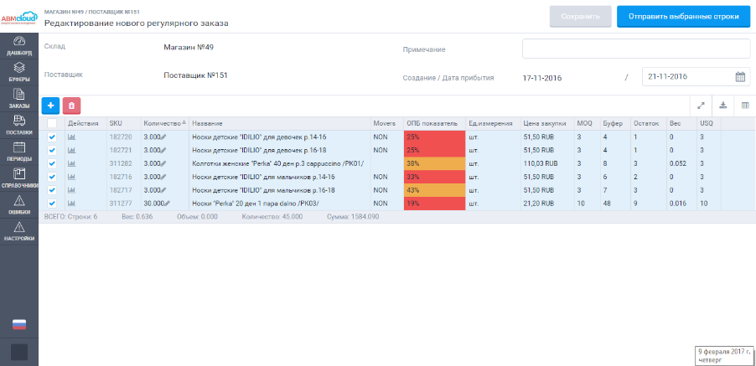
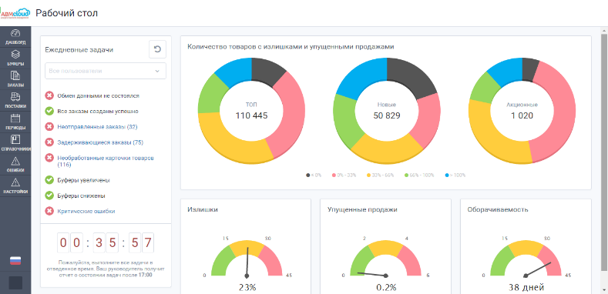
Multi-branch Chain
“Argon”

Slide 2
Choosing an executor and solution
To solve these problems, the ABM Inventory solution was chosen.
Why?
The solution is a high-quality software product that positively showed itself in the CIS countries and Europe.
A unique algorithm for daily replenishment
based on the
theory of constraint.
The project team is experienced specialists, quality and constant support.
Flexibility of the system. Integration with a "self-written" accounting system
Improvement of all work processes with orders, stocks, assortment, suppliers.
SaaS is a cloud-based solution that does not require investment.

Slide 3
Project background:
Decentralized orders system (total involved 15 people in each of the stores)
Manual order of each item
The quality of the order is low
The physical place for the formation of orders is in the client's accounting system on the enterprise servers
Inability to manage inventory properly and analyze the reasons for the shortage and surplus goods
The deficit for one commodity item and the surplus stocks for other items

Slide 4
The project in process:
01
Based on the software product a centralized system for order and inventory management has been created
02
The data exchange between
customer's accounting system
ASTOR and ABM Cloud inventory management system
03
To the inventory management system
connected 92 thousand SKU and 100 suppliers
At the initial stage for each
positions the buffers are calculated, then
The system automatically arranged for
current demand.
04
05
Cross-docking goods management

Slide 5
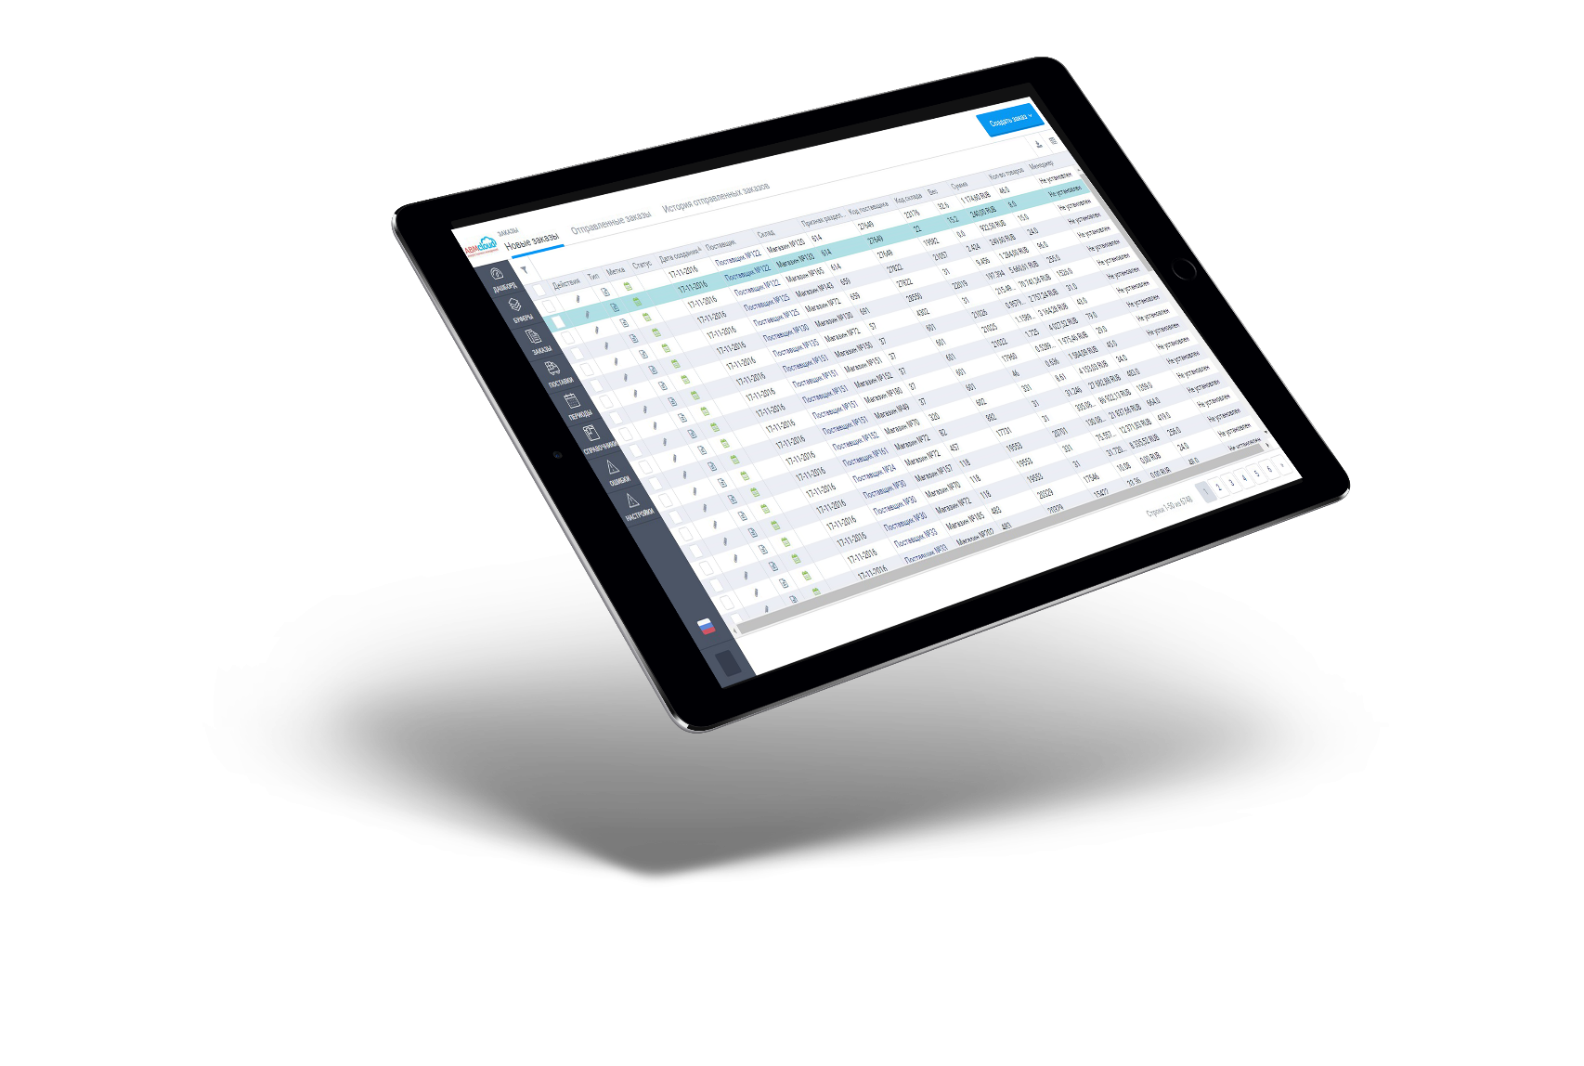
Results and effects:
3 people manage 80 000 SKU. Optimization of personnel
The level of missed sales has been reduced to 2.4% (from 10% to 12%)
Accelerated goods turnover
Reviewed and optimized supply schedules for many suppliers
Revised assortment matrices .
Optimized assortment,
do not deal with those goods that lie on the shelf and are not for sale

Slide 6
Contacts
EE + 372 884-00-64
UA +380 (44) 207-39-55 RU +7 (495) 204-15-09
sales@abmcloud.com
www.abmcloud.com

